Slide 1
Winery management
Destiny Bazan
Tyler Moon
Cassiany Noel

Slide 2
OVerview
We are a team of database developers tasked with designing a database solution for winery management, supplier relationships, wine production tracking, sales reporting, and employee management to optimize operations.

Slide 3

Brief Description of the Case Study
The case study revolves around developing a database system for a winery, which requires efficient tracking and management of various entities such as:
• Suppliers
• Wine production and inventory
• Distribution and sales reports
• Employee hours and departmental management
The goal is to create a relational database that maintains data integrity while providing reports to aid operational decision-making.

Slide 4

Finalized Entity-Relationship Diagram (ERD)
Link here

Slide 5
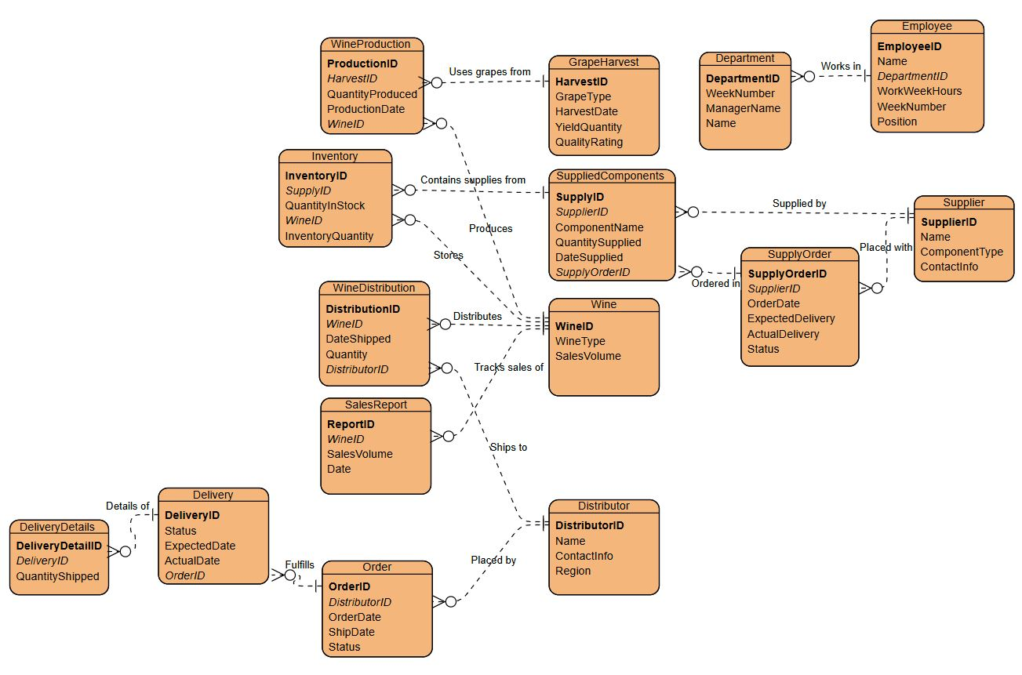
ERD Highlights
Entities include Supplier, Wine, Employee, Distributor, and SalesReport, each with defined relationships that help maintain data integrity across the database.
The diagram illustrates how different tables interact, ensuring seamless retrieval and manipulation of information pertinent to winery management.

Slide 6
Reports to generate
Supplier Performance Report
Wine Sales by Type and Distributor
Employee Hour Reports

Slide 7
Supplier Performance Report:
Supplier: Supplier A, Order Date: 2024-09-01, Expected Delivery: 2024-09-10, Actual Delivery: 2024-09-09, Delivery Difference: -1 days
Supplier: Supplier B, Order Date: 2024-09-05, Expected Delivery: 2024-09-12, Actual Delivery: 2024-09-12, Delivery Difference: 0 days
Supplier: Supplier C, Order Date: 2024-09-07, Expected Delivery: 2024-09-14, Actual Delivery: 2024-09-13, Delivery Difference: -1 days
Supplier: Supplier C, Order Date: 2024-09-07, Expected Delivery: 2024-09-14, Actual Delivery: 2024-09-13, Delivery Difference: -1 days
Supplier: Supplier A, Order Date: 2024-09-04, Expected Delivery: 2024-09-16, Actual Delivery: 2024-09-15, Delivery Difference: -1 days
Supplier: Supplier C, Order Date: 2024-09-06, Expected Delivery: 2024-09-20, Actual Delivery: 2024-09-19, Delivery Difference: -1 days

Slide 8
Wine Sales by Type ane Distributor
Wine: Merlot Reserve, Type: Red, Distributor: Distributor One, Total Sales: 1050
Wine: Merlot Reserve, Type: Red, Distributor: Distributor Five, Total Sales: 1050
Wine: Cabernet Estate, Type: Red, Distributor: Distributor Two, Total Sales: 850
Wine: Cabernet Estate, Type: Red, Distributor: Distributor Six, Total Sales: 850
Wine: Chablis Premium, Type: White, Distributor: Distributor Three, Total Sales: 350
Wine: Chardonnay Classic, Type: White, Distributor: Distributor Four, Total Sales: 250
Type: Red, Wine: Merlot Reserve, Total Sales: 1050
Type: White, Wine: Chablis Premium, Total Sales: 350
Worst Selling Wines by Type:
Type: Red, Wine: Cabernet Estate, Total Sales: 850
Type: White, Wine: Chardonnay Classic, Total Sales: 250

Slide 9

Employee hours report
Employee: Janet Collins, Total Hours Worked: 40 hours
Employee: Roz Murphy, Total Hours Worked: 37 hours
Employee: Bob Ulrich, Total Hours Worked: 50 hours
Employee: Henry Doyle, Total Hours Worked: 40 hours
Employee: Maria Costanza, Total Hours Worked: 40 hours
Employee: John Smith, Total Hours Worked: 40 hours

Slide 10
Assumptions Made about the case study​
Data Integrity and Relations:
All foreign keys will correctly relate to their respective primary keys.
Data Completeness:
All necessary tables, fields, and relationships required for the business functions are included and mapped correctly, such as employee roles, wine types, and distributor details.
Version and Updates:
Assumes the database will be updated regularly with new data entries and modifications, requiring query flexibility.

Slide 11
Conclusion
This case study has outlined the foundational elements required for managing a winery database effectively. A relational database management system enables optimal data organization, real-time reporting, and improved operational efficiency. This solution will significantly benefit the winery's management by maintaining a comprehensive overview of its various processes and entities.

Slide 12
THANK YOU
CSD_310

